Slide 1
DSD - ASVS
Google Big query

Slide 2





Agenda
Problem Statement
BigQuery
Role of Distributed Systems in Big Query
Demonstation
Q/A

Slide 3
Problem Statement
HOME CREDIT DEFAULT ANALYSIS USING GOOGLE BIG QUERY

Slide 4




BIGQUERY
BigQuery is a fully managed enterprise data warehouse that helps you manage and analyze your data with built-in features like machine learning, geospatial analysis, and business intelligence.

Slide 5
Why BigQuery
Service for interactive analysis of massive datasets (TBs)
Query billions of rows: seconds to write, seconds to return
Uses a SQL-style query syntax
It's a service, can be accessed by an API
Reliable and Secure
Replicated across multiple sites
Secured through Access Control Lists
Scalable
Store hundreds of terabytes
Pay only for what you use
Fast (really)
Run ad hoc queries on multi-terabyte data sets in seconds

Slide 6

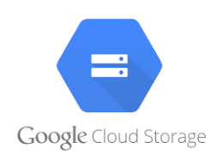

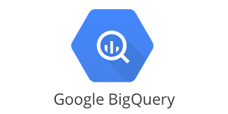
Overall Architecture – Google Cloud Platform
Kaggle Data Repository
Google Cloud Storage [Data Storage]
Google Data Studio
(Data Visualization)
Google Big Query
(Data Processing)

Slide 7
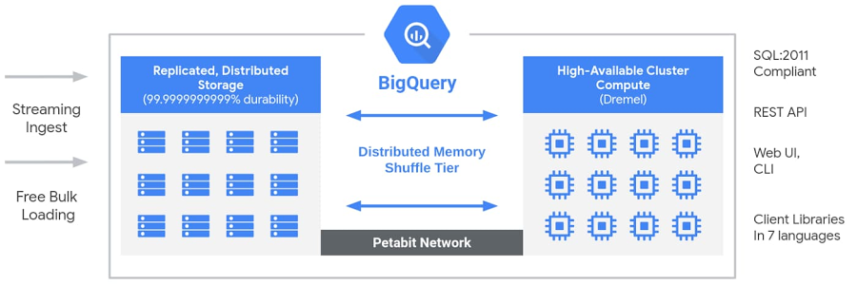
Architecture of BigQuery 1. Replicated Distributed Storage : Colossus 2. Cluster Compute : Dremel 3. high speed network : petabit 4. Borg

Slide 8
Role of Distributed Systems in Big Query
Colossus: Distributed Storage
Next-generation cluster-level file system
Automatically shaded metadata layer
Data typically written using Reed-Solomon
ColumnIO storage format
A successor of Google Data Storage
Data stored in a columnar fashion
Highly advanced compression algorithm
Federated Query Engine
Query data from any Google service without data movement

Slide 9




Features
CONCURRENCY
SCALABILITY
FAULT TOLERENCE & REPLICATION
SECURITY

Slide 10




Demonstration
PostgreSQL
Oracle
BigQuery
Comparison

Slide 11
ANY QUESTIONS?

